Slide 1
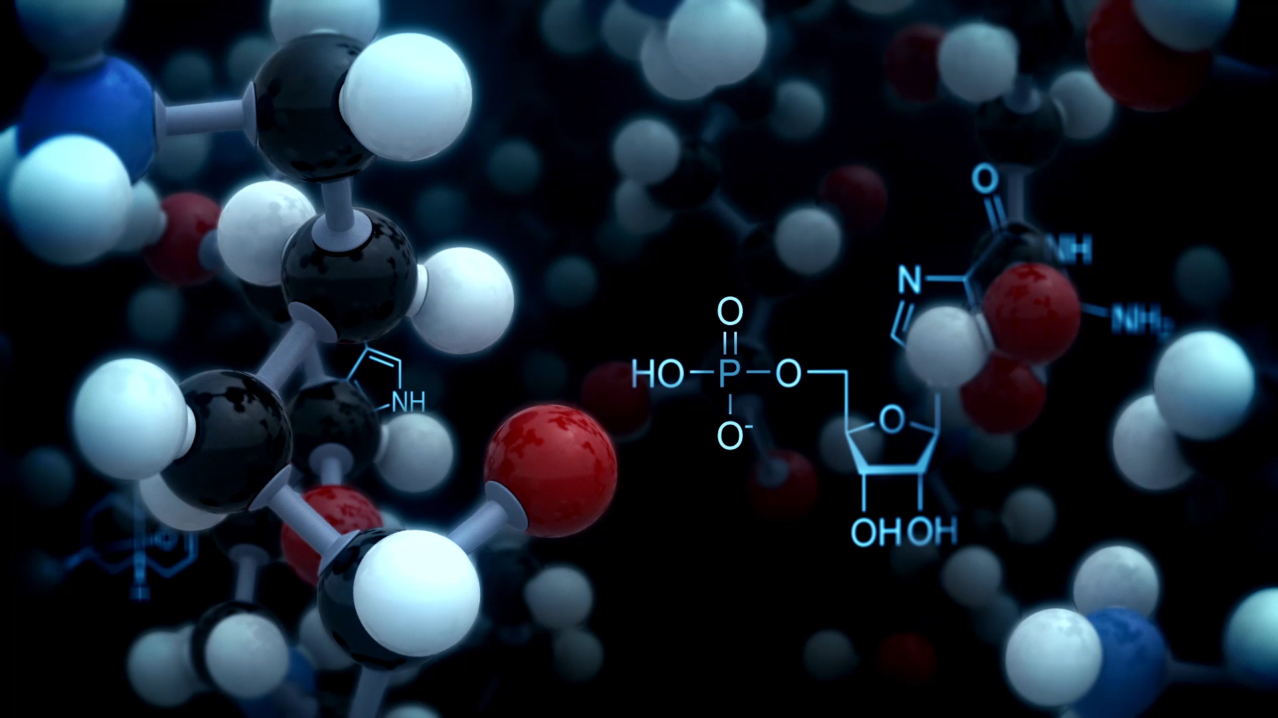
Separation and Purification of the protein content in Garcinia kola
Ferdinand Oghenereke Avikpe
Supervisors:
Dr. Michael Eze
Dr. Jamie Galka
Dr. Athar Ata

Slide 2
Introduction
Traditional plant-based medicines remain the primary source of healthcare in many parts of the world especially in many rural areas in Africa, Asia, and Central and South America.
A common traditional medicine source used in West and Central Africa to treat different illnesses and the focus of this study is Garcinia kola. This plant is found in moist forest, riverine and swampy areas in Benin Republic, Cameroon, Democratic Republic of Congo, Cote d’Ivoire, Gabon, Ghana, Liberia, Nigeria, Senegal, and Sierra Leone, all in West and Central Africa. Nigeria and Cameroon are considered the countries with the highest presence of Garcinia kola.
The uses of Garcinia kola can be classified into traditional, medicinal, and economical.
Notes:
Traditional plant-based medicines remain the primary source of healthcare in many parts of the world. This is especially true in many rural areas in Africa, Asia, and Central and South America, where plants and knowledge of traditional uses are readily available and inexpensive. In these regions, modern medicine is not a readily available choice. Hence, in such countries, the use of plant materials to treat a wide range of ailments and diseases is a frequent and widespread practice.

Slide 3
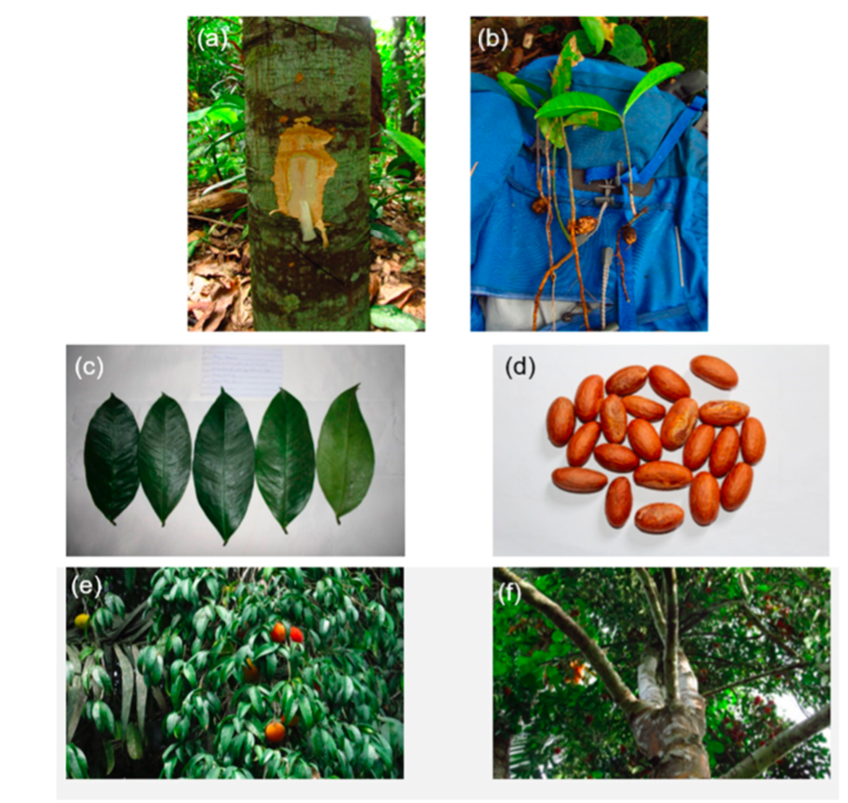
Uses of Garcinia kola
Traditional: Seeds are offered to visitors as form of welcome, used during ceremonies related to marriage, child naming, funerals and in sacrifices made to various gods and goddesses of African mythology.
Medicinal:
Garcinia kola on its own, is a tree that is often called the ‘wonder plant’.
The seeds aid digestion and have been used to treat cough, gastric problems, diarrhea, constipation, abdominal pains, headaches, malaria, bronchitis, laryngitis, gastroenteritis, rheumatism, asthma, liver diseases, menstrual cramps even snake bites.
Industrial/Economical:
Industrial preparation of Coca-Cola, Pepsi Cola, kola wine.
Production of jam, tannins, preservatives, fertilizer, animal feed.

Slide 4
Challenges of Extracting Proteins
Author | Crude Protein Content
Odebunmi et al. (2009)ª | 2.48 ± 0.10%
Ibekwe et al. (2007)^{b} | 0.58% dry wt. basis
Esiegwu & Udedibie (2009)^{c} | 2.64% dry wt. basis
Eleyinmi et al. (2006)^{d} | 3.95 g/100 g
Dosunmu & Johnson (1995)^{e} | 7.8 ± 0.8 g/100 g
Onyekwelu et al. (2015)^{f} | 1.74 ± 0.00% fresh wt. basis
Asaolu (2003)^{g} | 4.25% fresh wt. basis
Arogba (2000)^{h} | 7 ± 0.2% dry wt. basis
Adesuyi et al. (2012)^{i} | 1.86 ± 0.15%
Manourova (2017)^{j} | 6.48 ± 1.12% dry wt. basis
Mazi et al. (2013)^{k} | 11.27 ± 0.0306% dry wt. basis
While there has been some research done to understand and characterize plant proteins – in this case Garcinia kola – the information and data obtained from these studies are far from being comprehensive.
Plant proteins are more difficult to extract because they are protected by a thick cell wall that contains a variety of interfering agents.
Seeds do not contain a lot of proteins.
Proteins are highly complex macromolecules that are structurally and functionally different from each other and highly sensitive to changes in their native environment.

Slide 5
Research Objectives
To propose an effective extraction technique for extracting proteins.
To extract and purify the protein and polypeptide components in the seeds of Garcinia kola. The purified protein samples will be further processed and profiled to check for biological active peptides.

Slide 6
Methodology
Sample preparation via slicing (with callus shaver), oven-drying and grinding.
Defatting with petroleum ether
Protein extraction using the urea/thiourea solubilization method
Dialysis
Protein precipitation using the ammonium sulfate precipitation method (30%, 60%, 90% saturation)
SDS-PAGE analysis on the protein isolates to determine the molecular weights of the extracted polypeptides
Bradford Assay to determine the protein content of the samples.

Slide 7
Results and Discussion
Protein abundance can be determined by the intensity of staining and the thickness of the bands. By examining which samples displayed more intense bands, we determined which experimental conditions resulted in an overall efficient protein isolation. Both main bands of 8 kDa were seen in the isolated proteins from samples FA-2-30 and FA-2-60. The bands on the protein isolates from the other sample was less strong. As a result, ammonium sulphate precipitation of proteins in G. kola seeds is most efficient when the proteins are separated between 30% and 60% saturation, or within this range.
The kernels of the seeds had a protein content of 0.0009% while the hulls were discarded.

Slide 8
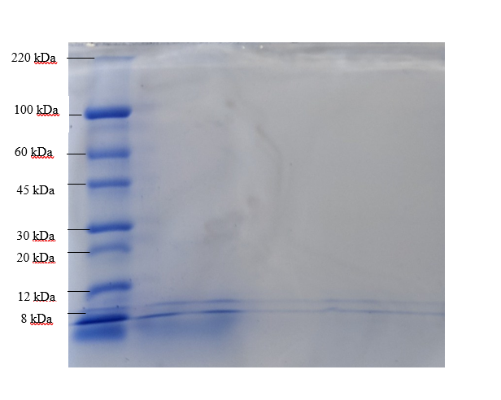
Results and Discussion
The 8-kDa polypeptide band may be from a non-specific lipid transfer protein (nsLTP) fraction, based on literature findings.
Additionally, in terms of amino acid composition, a study performed by Revilleza et. al suggests that the 8 kDa band observed on the gel contains methionine and cysteine and was characterized by high contents of glutamic acid, aspartic acid, and arginine.
Negative correlation between carbohydrate content and protein solubility.

Slide 9
Conclusion and Future Directions
In recent years, there has been a significant increase in the demand for plant proteins as an alternative to animal proteins as plant proteins are becoming an appealing alternative in the hunt for new and sustainable protein sources.
From this study, we successfully proposed an extraction technique that worked effectively. The results obtained here would be useful in looking at the total nutritional worth of the proteins in G. kola seeds, as well as their potential for additional applications such as bioactive peptide production and food texture modification.
Further research may wish to perform extraction on a larger scale to obtain more tangible and useful results.
Comparative proteomic analysis is another analytical method that can be looked into. Comparative proteomics examines changes in the proteome as a result of development, disease, or the environment.

Slide 10

Questions

Slide 11
Acknowledgement
I would like to thank my supervisors, Dr. Michael O. Eze, Dr. Jamie Galka and Dr. Athar Ata for the dedicated guidance, advice and support they have given me throughout this research project. Each of my supervisors played very important roles that were fundamental to my success in this project. I want to thank Dr. Jamie Galka who took time out of his wonderful summer break to constantly be with me in the lab and provide guidance when I needed. I also want to thank Dr. Michael O. Eze for his time, support, and constructive feedback and finally for encouraging me to take on this project. Furthermore, I want to thank Dr. Athar Ata for his support and encouragement. Lastly, I want to acknowledge Jamie Petrachek for the help she provided to me in the lab. It was truly a privilege to work on this project alongside such motivated and smart scientists.
My appreciation also goes out to my family and friends for their encouragement and support all through my studies.

